Slide 1


Slide 2

I Want To Go Faster!
A beginner’s guide to indexing

Slide 3






Bert Wagner
@bertwagner
bertwagner.com
youtube.com/c/bertwagner
bert@bertwagner.com
Notes:
I'm a performance-driven Business Intelligence developer - In my world every single project dictates incredibly fast performance, so I need to know how to work with the database to meet those requirements.
I’m a SQL Server blogger and YouTuber
Outside of SQL, I’m in search of brewing the perfect cup of coffee and outdoors enthusiast.

Slide 4
Why
Indexes?
Usually they’re the easiest way to get improved read performance for many queries at once
Can have downstream benefits like solving blocking, caching problems
Notes:
That doesn't mean they don't come without a cost/Not always the *right* way to fix a problem
Hard drive space
Insert/update/delete performance

Slide 5
Why
Indexes?
NOT
They take up space
Every index adds overhead on insert, updates, deletes
Maintenance
Fragmentation – external and internal
Ownership
Maintenance windows introduce blocking, downtime, coordination
Notes:
Space – consumer harddrives are cheap, enterprise storage and san not always. One more thing to affect your planning and budgets.
Overhead – every time data in table changes, your indexes need to be pdated to reflect those changes
That means every operation that’s not a read will be slower.
Maintenance – they are like a pet. They live with you, you need to take care of them, otherwise they start smelling bad, don’t clean themselves, bark at the neighbors
- external (physical page order doesn’t match logical – this is not as big of a problem for SSDs)
- Internal (page density/free space from page splits)
- Someone owns. This is ripe area for automating, but you need to be sure you make the time to do it, document it, etc… Lots of free scripts to help with this, but at end of the day it’s just one more thing you have to do.

Slide 6
When you need to index
You have many different queries running slowly against a table (or multiple tables)
You have one query with lots of executions is slow (tune first)
You see Microsoft’s green index recommendations in execution plans
Seeing lots of scans in execution plans
Other warning signs:
Excessive blocking
Low Page Life Expectancy (PLE)
Notes:
Single query lots of excutions - (if single query, might refactor query first but ultimately index can speed up)
Scans - Not all scans are necessarily bad. But if you only see scans, or your seeing scans and NOT returning lots of data, then you might have opportunity
Index recommendations-Some people hate these, but I like them! Don't use them blindly though.
If experiencing blocking (the less data dense pages you have, the more likely blocking will occur)
If data isn't staying cached (physical reads instead of logical reads, statistics io), maybe you're reading too much in (scans)
sidenote: all data, read, inserted, or update, travels through SQL Server's memory, or buffer pool, first
if running ssds, it's definitely faster, but there is still some cost of buffer pool, and ssds are still order of magnitude slower than memory
if PLE is low, then you aren't utilizing caching which will mean things are slower
If you want speed - fewer pages - more data density - less to read and things are faster
Microsoft recommendations
some people hate them. why? sometimes they are really dumb. It's like you can program all of these logical steps that we are talking about how to program and index, and microsoft programmed them but some how the index recommendations always stop after the first step
They also are not always optimal. there can be multiple indexes for a table, but microsoft only shows the first. the first isn't necessarily always the better one.
They are not consistently there
I love them. they make easy to find great starting points.
sp_BlitzIndex is incredible. If you need to tune queries at a database or server level, this script summarizes all changes neatly and in one place, allowing you to blast through cleaning up a poor performing database very quickly.

Slide 7

Index Internals

Slide 8
Heap
Stack of pages graphic – 1000 pages – need to only read 10 pages to find the one I need. B trees a little more efficient than that, but same idea
One individual page graphic
Every operation is a scan
Notes:
Stack of pages - this is our table
Each page has information about a bird on it – the bird’s name, picture, description, habitat, migration patterns, visual markings, etc… You can think of each of these pages as a row of data.
No enforced order: it’s a heap. Searching for individual birds is time consuming; if you want blue bird, have to go through page by page until you find the right entry.
The scanning doesn’t stop there though. Even though we find 1, there's no guarantee that's the only one. This means we have to continue flipping through every page until we finish searching through the whole heap of pages.
Having to do this process every single time we need to retrieve data from our bird table is painful. To make our job easier, we can define and enforce an order on the data by defining a clustered index.

Slide 9
Clustered
3 Pages in alphabetical order. Same drawing, just change name, colors
Bound book graphic
This allows us to seek – divide in half and conquer
Notes:
Clustered index is our table. Exactly like our heap, just now data is in a specific order. It's like we sorted our pages alphabetical by bird name and then bound them together into a book.
Repeat - the clustered index is our table. Just in a sorted order.
Our index “key” columns are those that the data is sorted on
Having data in sorted order by bird name makes certain queries really fast and efficient
instead of having to scan through every page to find the blue bird entry, we can now quickly flip to the “B” section, then the “BL” section, then the “BLU” section, etc… until we find BLUE JAY. This is done quickly and efficiently because we know where to find blue jays in the book because the bird names are stored in alphabetical order
Even better, after we find the blue jay page, we flip to the next page and see a page for cardinal. Since we know all of the entries are stored alphabetically, we know that once we get to the next bird we have found all of our blue jay pages and don’t need to continue flipping through the rest of the book.
While the clustered index allows us to find birds by name quickly, it’s not perfect; since the clustered index is the table, it contains every property (column) of each bird, which is a lot of data!
Having to constantly reference this large, clustered index for each of my queries can be too cumbersome. For most of our queries, we could get by with condensed version of my bird book that only contains the most essential information in it.

Slide 10
Nonclustered
3 Pages in alphabetical order. But multiple birds per page
Bound book graphic
Seeking even faster because we have less pages to search
Notes:
I like to think of NC indexes as staged data. It's stored in a format that will make certain queries quicker to retrieve.
Let’s say we want a lighter-weight version of our book that contains the most relevant information (bird name, color, description).
We can photocopy the entire book and then cut out and keep only the pieces of information that are relevant while discarding the rest. If we paste all of those relevant pieces of information into a new book, still sorted by bird name, we now have a second copy of our data. This is our nonclustered index.
This nonclustered index contains all of the same birds as my clustered index, just with fewer columns. This means I can fit multiple birds onto a page, requiring me to flip through fewer pages to find the bird I need.
If we ever need to look up additional information about a particular bird that’s not in our nonclustered index, we can always go back to my giant clustered index and retrieve any information we need.
With the lighter-weight nonclustered index in-hand, we go out to the woods to start identifying some birds.
Upon spotting an unfamiliar bird in our binoculars, we can flip open the nonclustered index to identify the bird.
The only problem is, since we don’t know this bird’s name, our nonclustered index by bird name is of no help. We end up having to flip through each page one at a time trying to identify the bird instead of flipping directly to the correct page.
For these types of inquires where we want to identify a bird don’t know the bird’s name, a different index would beneficial…

Slide 11
Nonclusered part 2
3 Pages in color order. Size order second But multiple birds per page
3 Bound books graphic,2 same size
This index is perfect for a specific type of query where we need to look up data based on order
Notes:
Instead of having a nonclustered index sorted by bird name, what we really need is a way to filter down to the list of potential birds quickly.
One way we can do this is to create another copy of my book, still containing just bird names, colors, and descriptions, but this time order the book pages so they are in order of color first, then bird name.
When trying to identify an unknown bird, we can first limit the number of pages to search through by filtering on the bird’s color. In our case, color is a highly selective trait, since it filters down our list of potential birds to only a small subset of the whole book. In our blue jay example, this means we would find the small subset of pages that contain blue birds, and then just check each one of those pages individually until we find the blue jay.
Once again...I like to think of NC indexes as staged data. It's stored in a format that will make certain queries quicker to retrieve.

Slide 12
A Quick Note about Primary Keys
PKs != Clustered Indexes
PKs are a constraint that indicate column combination makes a row unique
You can have PK as a nonclustered index. Or a clustered index without a PK. They’re independent
Notes:
People often confuse Primary keys and clustered indexes becuase by default when you create a PK in SQL Server, it creates a clustered index.
A PK in SQL server is just a constraint indicating a combination of values makes a row unique. SQL Server enforces uniqueness via indexes (think back to finding blue jay - if data is sorted, we know if it exists or not and if there are any more)
So you can have a PK as a nonclustered index too. Or you can have a clustered index iwthout a PK. They are independent.

Slide 13
Summary
Indexes solve two big problems:
Sort Your Data
JOIN, WHERE, GROUP BY, etc… can utilize this pre-sorted data.
Allow for Higher Data Density
So there’s less data pages to read

Slide 14
Any questions so far?

Slide 15
QUIZ TIME! Does index column order matter?
Does key column order matter?
Imagine a book of birds sorted on bird name, will it help me find unknown birds?
No – it’s better to sort on some other attribute first, such as color.
Imagine my book has 100 birds – evenly distributed across 20 distinct colors and 5 different sizes. Do I sort on color first, or by size?
Color – it’s more selective b/c it leaves me with 5 options. Sorting on size first would leave me with 20 options.
Does include column order matter?
Include columns are primarily there to prevent your queries from having to go to a different index to get additional columns. Order doesn’t matter here.
Notes:
Our SELECT queries from a database typically require Filters, sorts, joins
Key columns is a quiz
Include is not
If i need all data for one bird, i don't really care about hte order. It's already organized together, i have access to display it on my book page, website, whatever
Included columns hold data that you want to display/bring back, but aren't filtering/sorting/joining on.

Slide 16
Common Indexing Recommendations
These are suggestions, not absolutes!
They are good to get you going, but they won’t be the best option in every scenario (especially complex situations).
But they are good starting points.
Notes:
I’M GOING TO LIE TO YOU - not a real good selling point, huh?
Best practices! Almost every piece of advice I give you today Can be wrong in certain scenarios. So know that you can follow this advice most of the time, but down the road as you build more advanced queries and processes, just know that there’s pretty much always an exception to the rule.
joins
where
group by - all of these operations benefit from sorted data.
most highly selective column as first key, not changing (don't want to update)

Slide 17
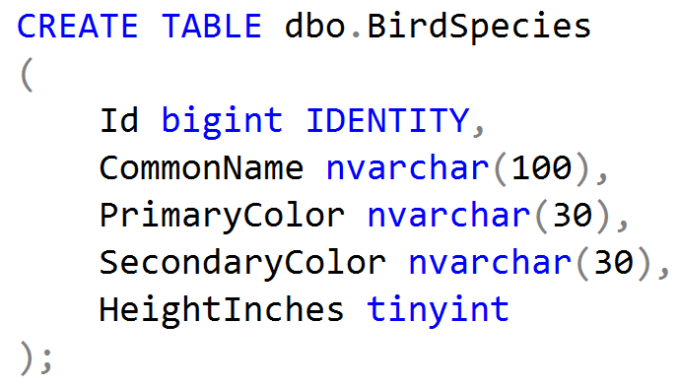
Heap
Notes:
CREATE TABLE dbo.BirdSpecies
(
Id bigint IDENTITY,
CommonName nvarchar(100),
PrimaryColor nvarchar(30),
SecondaryColor nvarchar(30),
HeightInches tinyint
);

Slide 18
Heap
Benefits:
If no clustered index, it means data can be written quickly wherever there is free space. Possibly useful in ETL staging.
Disadvantages:
A well-defined clustered index will almost always beat out a heap.
Every operation that is not an insert will be as fast or significantly faster on a clustered index than on a heap.
Recommendation:
Don’t use them.
Notes:
INCLUDE DEMO SCRIPT: just CREATE TABLE. No PK. No index. No nothing.
Staging data
If straight insert, then straight read, and you don't care about order, then MAYBE this is the fastest.
Usually I end up writing queries to transform staged data thoguh, so I rarely have a scenario where this works. It's a hypothetical scenario that should work, but doesn't come up often in the real world.
Heaps are REALLY bad for all other scenarios - table scans, forwarded records (once a record outgrows a page, like with an UPDATE, sql moves data to new page and leaves behind a forwarding pointer. Each read requires 2 or more pages read!)
CLustered index that's built on an ever increasing key will nearly always be faster at inserting data (because of extra pages inserted into heaps, using estiamtes for free space)

Slide 19
Clustered Index
Benefits:
Better than a heap 99% of the time.
Can make lookups quicker.
Disadvantages:
A poorly defined clustered index could take up extra space and be inefficient.
Other Notes:
You get one per table – choose wisely!
The clustering key gets copied to every nonclustered index page…don’t make it wide (either # of columns or byte size of columns)
Notes:
INCLUDE DEMO SCRIPT: just CREATE TABLE. No PK. No index. No nothing.
Staging data
If straight insert, then straight read, and you don't care about order, then MAYBE this is the fastest.
Usually I end up writing queries to transform staged data thoguh, so I rarely have a scenario where this works. It's a hypothetical scenario that should work, but doesn't come up often in the real world.
Heaps are REALLY bad for all other scenarios - table scans, forwarded records (once a record outgrows a page, like with an UPDATE, sql moves data to new page and leaves behind a forwarding pointer. Each read requires 2 or more pages read!)
CLustered index that's built on an ever increasing key will nearly always be faster at inserting data (because of extra pages inserted into heaps, using estiamtes for free space)

Slide 20
Clustered Index
Recommended keys for a clustered index:
Int/bigint IDENTITY – will guarantee uniqueness, ever-increasing.
If I don’t know what to do, this is my default.
Datetime2 – ever increasing, may not be unique so might want to add a second IDENTITY column as part of the key.
This is particularly useful if you are always going to be querying on that datetime2 field.
Sequential GUIDs – ever increasing, unique across systems
Only would use this option if need a unique value across tables, servers.
Notes:
ID - int or big int is small and unique
We want our cluster key to be unique, otherwise sql will add a uniqueifier behind the scenes anyway.
Internally, CL keys get copied to every index page (point back to where they find other data for key lookups)
not something that will change. for example if we represent a record by a datetime will get updated, later, we don't want to use that
datetime ok too, but if multiple row inserts per transaction, possible won't be unique. create on datetime,smallint, tinyint depending on level
this works well if a lot of your queries will be filtering on that date range
guid?
sequential guids sure
Unique across every table, every database and every server
Allows easy merging of records from different databases
Allows easy distribution of databases across multiple servers
You can generate IDs anywhere, instead of having to roundtrip to the database
Most replication scenarios require GUID columns anyway

Slide 21
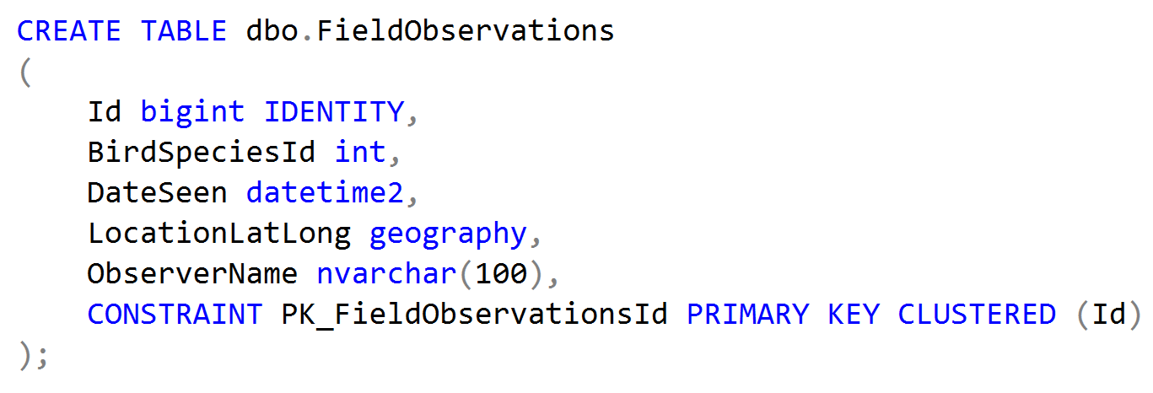
Clustered Index - Identity
Notes:
CREATE TABLE dbo.FieldObservations
(
Id bigint IDENTITY,
BirdSpeciesId int,
DateSeen datetime2,
LocationLatLong geography,
ObserverName nvarchar(100),
CONSTRAINT PK_FieldObservationsId PRIMARY KEY CLUSTERED (Id)
);

Slide 22
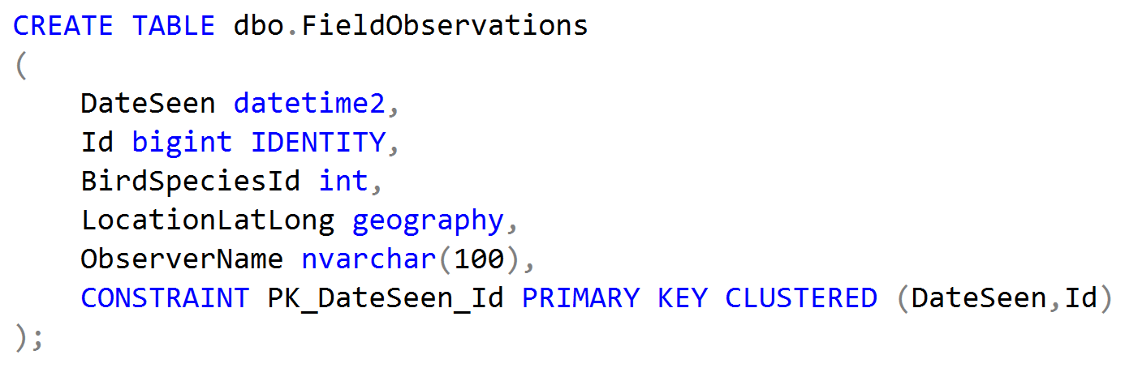
Clustered Index – Datetime2 + identity
Notes:
CREATE TABLE dbo.FieldObservations
(
DateSeen datetime2,
Id bigint IDENTITY,
BirdSpeciesId int,
LocationLatLong geography,
ObserverName nvarchar(100),
CONSTRAINT PK_DateSeen_Id PRIMARY KEY CLUSTERED (DateSeen,Id)
);

Slide 23
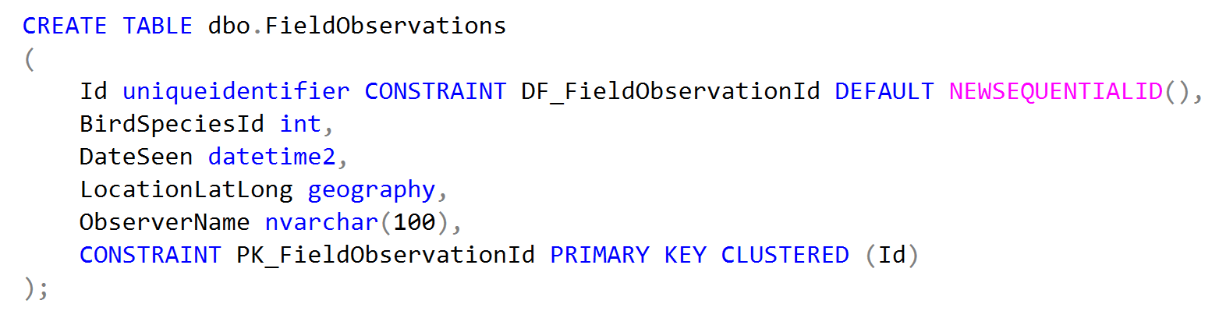
Clustered Index – Sequential GUID
Notes:
CREATE TABLE dbo.FieldObservations
(
Id uniqueidentifier CONSTRAINT DF_FieldObservationId DEFAULT NEWSEQUENTIALID(),
BirdSpeciesId int,
DateSeen datetime2,
LocationLatLong geography,
ObserverName nvarchar(100),
CONSTRAINT PK_FieldObservationId PRIMARY KEY CLUSTERED (Id)
);

Slide 24
Nonclustered Index
Benefits:
Can store data sorted in a different order.
Can store data with fewer columns (greater density)
Disadvantages:
Use extra space.
Need to be modified on every insert/update/delete.
Need to be maintained for fragmentation.

Slide 25
Nonclustered Index
Recommended keys for a nonclustered index:
Foreign keys – fields used to join on (regardless if they have a FK constraint or not)
WHERE predicates – if a query is filtering on a subset of rows
GROUP BYs – if using GROUP BYs or window functions, use your grouping/partitioning columns as keys

Slide 26
Nonclustered
single query example
two queries that need slightly different columns
search query multiple columns - normalize!

Slide 27

Thank you!
@bertwagner
bertwagner.com
youtube.com/c/bertwagner
bert@bertwagner.com
New posts and videos every Tuesday!

Slide 28
Appendix - When do indexes hurt
Hotspots - last page is constantly being locked by inserts - this can slow things down. This may be a time where a clustered index may not want to be on something incremental like identity or date. GUIDs actually solve some performance issues here *shudder*
If you have a query that is slow, but runs once per month for reporting, don’t index it. Either deal with the slow tradeoff, or do something like run a job to create that index then remove it after the job runs.
Insert/Update/Delete - every time this happens, every index must be modified
page splits
fill factor
fragmentation (even ssds, fragmentation stinks bc still reading more pages into buffer pool
maintenance - operational burden. someone needs to run maintenance scripts. index maintenance scripts can have lots of problems with blocking. the more indexes you have to manage, the more possibilyt you have with trouble arising.

Slide 29
Appendix - Other types of indexes
Filtered, computed column index (storing preparsed data or fixing conversion issues without changing queries), Columnstore (analytical queries), spatial, hierarchical, xml, etc..
Link to resources

